Slide 1
CSE 3400 - Introduction to Cyber Security (aka: Computer and Information Security) Topic 4: Shared-Key Protocols
Prof. Amir Herzberg
Dept. of Computer Science & Engineering
University of Connecticut
Last updated: 3/30/2023

Slide 2
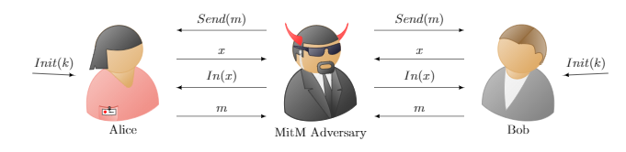
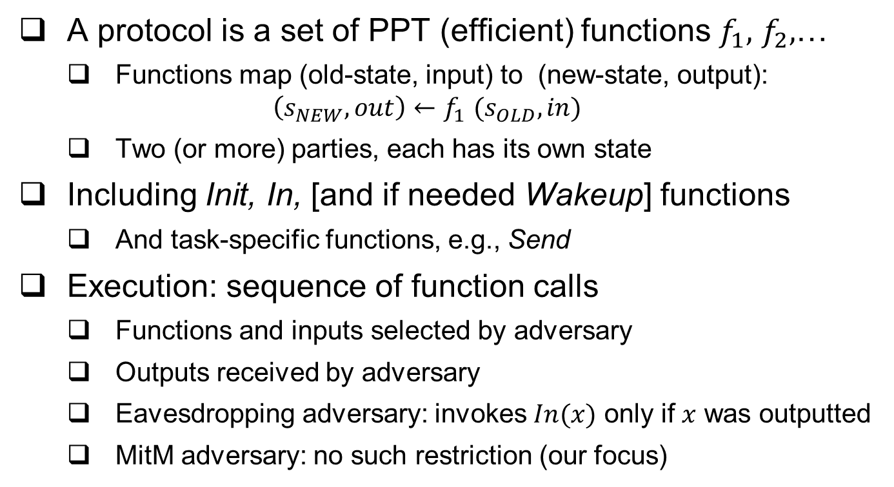
Cryptographic Protocols
A protocol is a set of PPT (efficient) functions $f_{1},$ $f_{2},$…
Functions map (old-state, input) to (new-state, output): $\left(s_{NEW},out\right){←f}_{1}(s_{OLD},in)$
Two (or more) parties, each has its own state
Including Init, In, [and if needed Wakeup] functions
And task-specific functions, e.g., Send
Execution: sequence of function calls
Functions and inputs selected by adversary
Outputs received by adversary
Eavesdropping adversary: invokes $In(x)$ only if $x$ was outputted
MitM adversary: no such restriction (our focus)
Notes:
In this lecture we focus on shared-key protocols

Slide 3
Cryptographic Protocols
A protocol is a set of PPT (efficient) functions
Each receiving (state, input), outputting (state, output)
Two (or more) parties, each has its own state
Including Init, In, [and if needed Wakeup] functions
And task-specific functions, e.g., Send
Adversary can invoke any function, handle outputs
Our discussion (from here) is mostly informal
Definitions of protocols, execution, goals are too `hairy’
Focus on shared-key, two-party protocols, MitM adversary
Record protocol: message authentication (+confidentiality?)
Later: handshake protocols
Notes:
In this lecture we focus on shared-key protocols

Slide 4
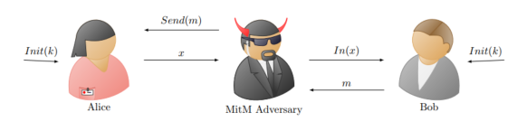
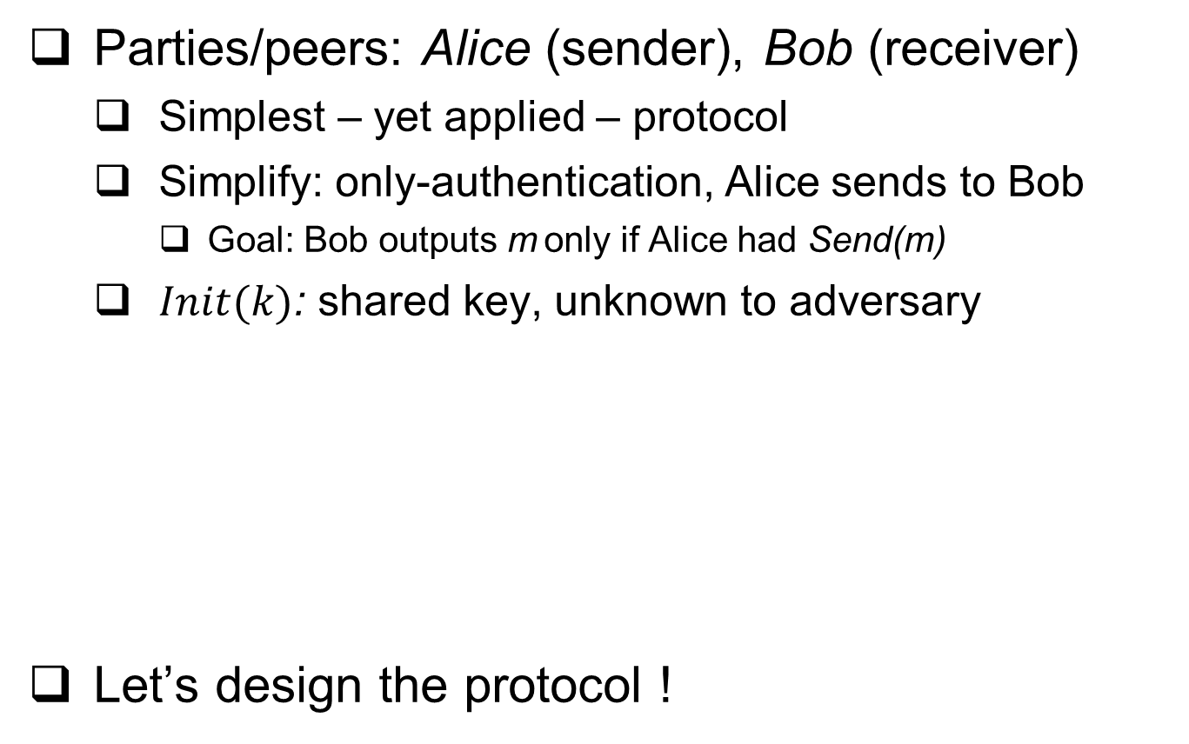
Two-party, shared-key Record protocol
Parties/peers: Alice (sender), Bob (receiver)
Simplest – yet applied – protocol
Simplify: only-authentication, Alice sends to Bob
Goal: Bob outputs m only if Alice had Send(m)
$Init(k)$: shared key, unknown to adversary
Let’s design the protocol !

Slide 5
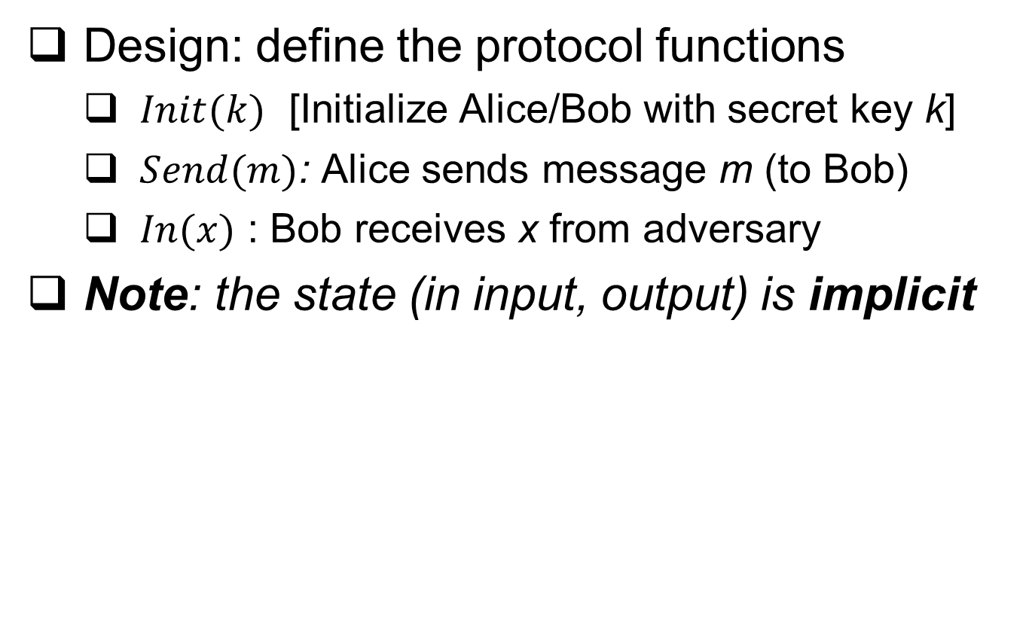
Design of Two-party, shared-key Record protocol
Design: define the protocol functions
$Init(k)$ [Initialize Alice/Bob with secret key k]
$Send(m)$: Alice sends message m (to Bob)
$In(x)$ : Bob receives x from adversary
Note: the state (in input, output) is implicit

Slide 6

Design of Two-party, shared-key Record protocol
Design: define the protocol functions
Init(k) [Initialize Alice/Bob with secret key k]
$\{s.k ← k; \}$
Save received key $k$ in state-variable $s.k$ (part of $s$)
$Send(m)$: Alice sends message m (to Bob)
$In(x)$: Bob receives x from adversary

Slide 7
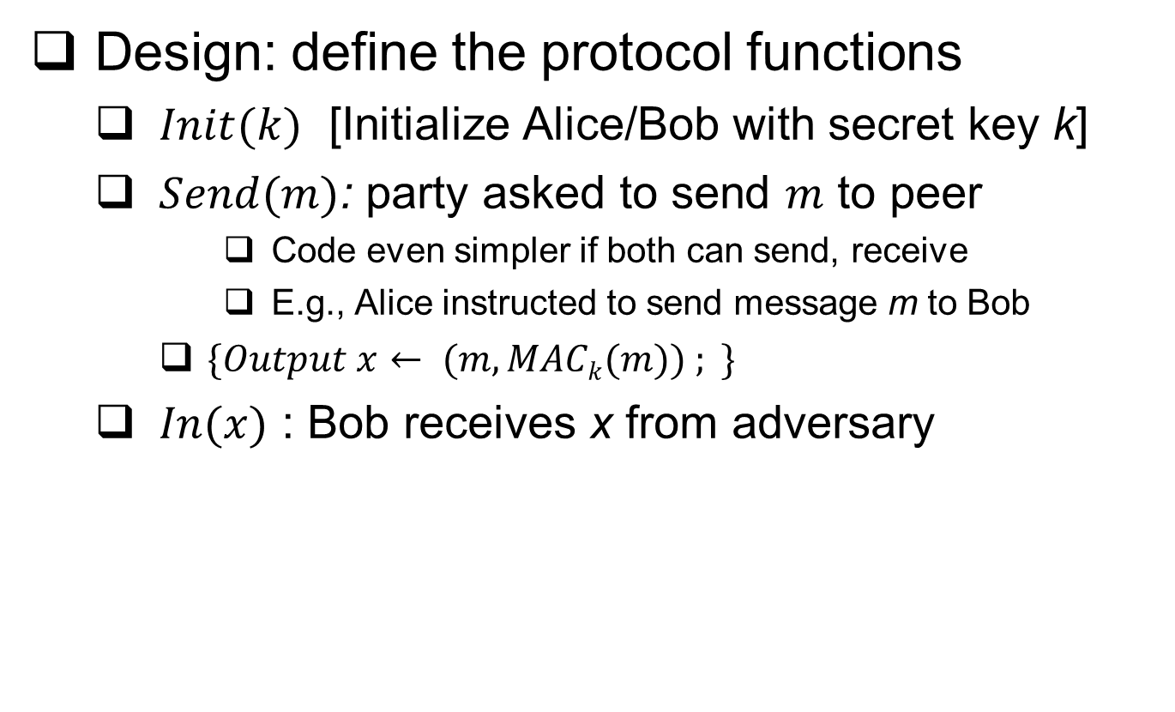
Design of Two-party, shared-key Record protocol
Design: define the protocol functions
$Init(k)$ [Initialize Alice/Bob with secret key k]
$Send(m)$: party asked to send $m$ to peer
Code even simpler if both can send, receive
E.g., Alice instructed to send message m to Bob
$\{Output x← (m, MACk(m)) ; \}$
$In(x)$ : Bob receives x from adversary

Slide 8

Design of Two-party, shared-key Record protocol
Design: define the protocol functions
$Init(k)$ [Initialize Alice/Bob with secret key k]
$Send(m)$: Party sends message m to peer
$In((m,σ))$ : Party receives $(m,σ)$ from adversary
$\{Output m$ if $(σ=MACk(m)) ;\}$
Output the message only if validated Ok

Slide 9
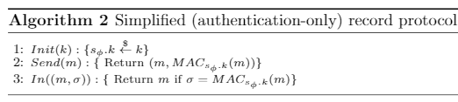

Design of Two-party, shared-key Record protocol
Design: define the protocol functions
$Init(k)$ [Initialize Alice/Bob with secret key k]
$\{s ← k; \}$[Save received key k in the state s ]
$Send(m)$: Alice sends message m (to Bob)
$\{Output x= (m, MACk(m)) ; \}$
$In((m,σ))$ : Bob receives $(m,σ)$ from adversary
$\{Output m$ if $(σ=MACk(m)) ;\}$

Slide 10
Two-party, shared-key Record protocol
Design many simplifications, easily avoided:
Only message authentication
No confidentiality!
Only ensure same message was sent
Allow duplication, out-of-order, `stale’ messages, losses
Also: no retransmissions, compression, …
To add confidentiality: use encryption

Slide 11


Two-party record protocol with Confidentiality
$Init(k)$ [Initialize Alice/Bob with secret key k]
$\{s ← k; \}$[Save received key k in the state s ]
$Send(m)$: Alice sends message m (to Bob)
$\{Output x= (Ek(m), MACk(m)) ; \}$
$In((c,σ))$ : Bob receives $(m,σ)$ from adversary
$\{Output Dk(c)$ if $(σ=MACk(Dk(c))) ;\}$
Vulnerable!! Why? How to fix ?
Weakness: $MACk(m)$ unencrypted → may expose $m$
This Photo by Unknown Author is licensed under CC BY-SA

Slide 12

Two-party record protocol: Encrypt-then-Auth.
Encrypt-then-Auth (EtA) is secure (and AtE ? )
$Init(k)$ [Initialize Alice/Bob with secret key k]
$\{s ← k$ ; }
$Send(m)$: Alice sends message m (to Bob)
$\{Output x= (E_{K}(m), {MAC}_{k_{A}}(E_{K}(m))) ; \}$
$In((c,σ))$ : Bob receives $(m,σ)$ from adversary
$\{Output Dk(c)$ if $(σ={MAC}_{k}(c)) ;\}$
May still be vulnerable ☹ …. Why??
This Photo by Unknown Author is licensed under CC BY-SA

Slide 13
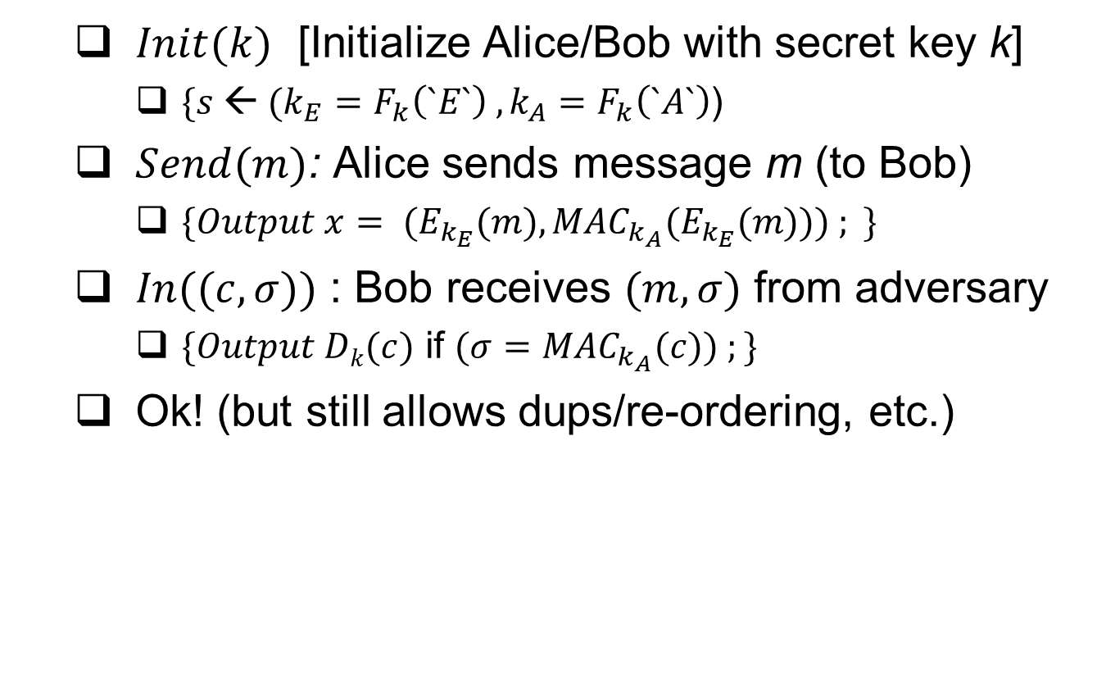
Two-party record protocol with Confidentiality
$Init(k)$ [Initialize Alice/Bob with secret key k]
$\{s ← (k_{E}=F_{k}\left(`E`\right) , k_{A}=F_{k}\left(`A`\right)$)
$Send(m)$: Alice sends message m (to Bob)
$\{Output x= (E_{k_{E}}(m), {MAC}_{k_{A}}(E_{k_{E}}(m))) ; \}$
$In((c,σ))$ : Bob receives $(m,σ)$ from adversary
$\{Output Dk(c)$ if $(σ={MAC}_{k_{A}}(c)) ;\}$
Ok! (but still allows dups/re-ordering, etc.)

Slide 14
‘Real’ Record Protocols Operations
Compress first
Remove redundancy
Encrypt-then-Comp fails
Length-leakage attacks!
Encrypt then Auth(EtA)
Prevent chosen ciphertxt
Don’t decrypt ‘garbage’
Add seq# to prevent duplication, reordering, loss
Finally, EDC / ECC
Error Detection / Correction Code
Detect forgery attempts
Message
Compress
Plaintext
Encrypt
Ciphertext
Seq#
MAC
Ciphertext
Seq#
tag
ECC
Seq#
Ciphertext
tag
ECC

Slide 15
Shared-Key Handshake and Record Protocols: Topics
Introduction to (shared key) crypto-protocols
Record protocols
Handshake protocols: entity authentication
Handshake: extensions
Key-setup handshakes
GSM handshake case study, and:
Key distribution
Ciphersuite negotiation and downgrade attacks
Improving resiliency to key exposures

Slide 16
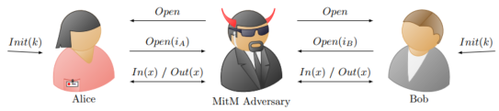
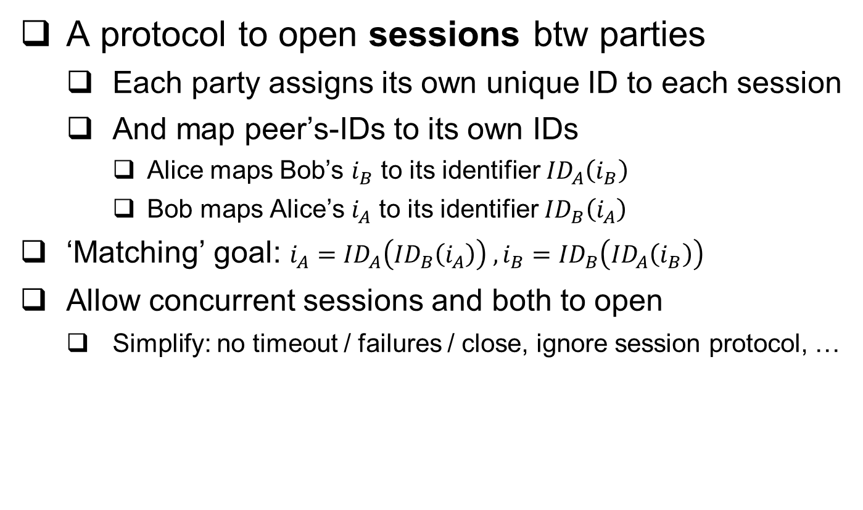
Handshake Entity-Authentication protocol
A protocol to open sessions btw parties
Each party assigns its own unique ID to each session
And map peer’s-IDs to its own IDs
Alice maps Bob’s $i_{B}$ to its identifier ${ID}_{A}\left(i_{B}\right)$
Bob maps Alice’s $i_{A}$ to its identifier ${ID}_{B}\left(i_{A}\right)$
‘Matching’ goal: $i_{A}={ID}_{A}\left({ID}_{B}\left(i_{A}\right)\right) ,i_{B}={ID}_{B}\left({ID}_{A}\left(i_{B}\right)\right)$
Allow concurrent sessions and both to open
Simplify: no timeout / failures / close, ignore session protocol, …

Slide 17
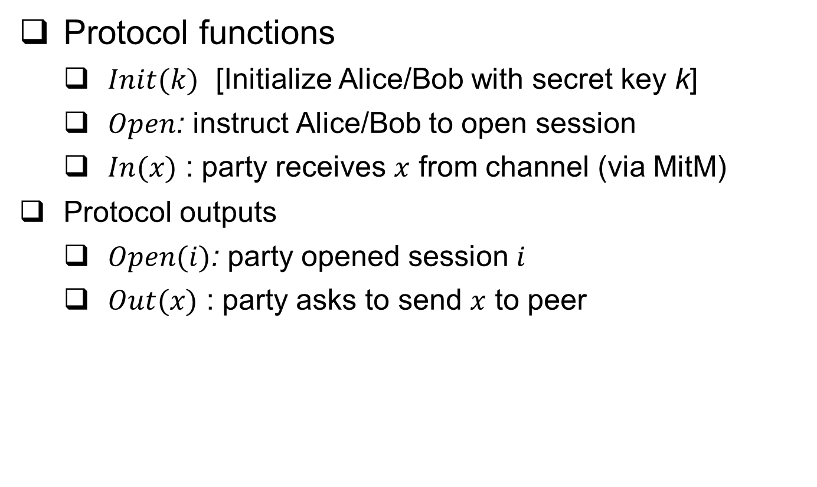
Handshake Entity-Authentication protocol
Protocol functions
$Init(k)$ [Initialize Alice/Bob with secret key k]
$Open$: instruct Alice/Bob to open session
$In(x)$ : party receives $x$ from channel (via MitM)
Protocol outputs
$Open(i)$: party opened session $i$
$Out(x)$ : party asks to send $x$ to peer

Slide 18
Example : IBM’s SNA Handshake
First dominant networking technology
Handshake uses encryption with shared key k
Alice
Bob
A, N_{A}
E_{k}(N_{A}),N_{B}
E_{k}(N_{B})
N_{a}, N_{b} - randomly chosen nonces
Insecure !! Why ?
SNA: IBM’s proprietary network architecture, dominated market @ [1975-1990s], mainly in banking, government.
3/30/2023
18
Notes:
3/30/2023
(c) Amir Herzberg, http://AmirHerzberg.com, Bar Ilan University
18
18
(c) Amir Herzberg, http://AmirHerzberg.com, Bar Ilan University
3/30/2023

Slide 19
Attack on SNA’s Handshake
MitM opens two sessions with Bob… sending N_{b} to Bob in 2nd connection to get E_{k}(N_{b})
MitM (spoofing as Alice)
Bob
Session 1
Session 2
Session 1
Session 2
A, N_{A}=1234
E_{k}(1234),N_{B}=5678
5678
A, N_{A}=5678
E_{k}(5678)
E_{k}(5678),N_{B}=9012
E_{k}(5678)
Alice `identified` (spoofed)
3/30/2023
19
Notes:
3/30/2023
(c) Amir Herzberg, http://AmirHerzberg.com, Bar Ilan University
19
19
(c) Amir Herzberg, http://AmirHerzberg.com, Bar Ilan University
3/30/2023
Exercise: fix the protocol (and attack fixes). E.g. why won’t it help if bob sends E_k(N_B) and wait for N_B (instead of sending N_B and waiting for E_k(N_B) ?

Slide 20
Fixing Mutual Authentication
Encryption does not ensure authenticity
Use MAC to authenticate messages
Prevent redirection
Identify party in challenge
Better: use separate keys for each direction
Prevent replay and reorder
Identify flow and connection
Prevent use of old challenge: randomness, time or state
Prevent chosen-plaintext, chosen-Ciphertext attacks
Do not compute values from Adversary
Include self-chosen nonce in the protected reply
Notes:
20
(c) Amir Herzberg, http://AmirHerzberg.com, Bar Ilan University
11/13/11

Slide 21



Two-Party Handshake Protocol (2PP)
A, N_{A}
N_{B} , Mac_{k}(2 || A←B ||N_{A} || N_{B} )
Alice
Mac_{k}(3 || A→B || N_{A} || N_{B} )
Bob
Use MAC rather than encryption to authenticate
Prevent redirection: include identities (A,B)
Prevent replay and reorder:
Nonces (N_{A},N_{B})
Separate 2nd and 3rd flows: 3 vs. 2 input blocks
Secure against arbitrary interleaving attacks [B*91]
Map msgs sent, received by Alice & Bob (except truncation)
Mac_{k}(2 || A←B ||N_{A} || N_{B} ): sent only by Bob when he gets A, N_{A}
Mac_{k}(3 || A→B || N_{A} || N_{B} ): sent only by Alice upon Mac_{k}(2 || A←B ||N_{A} || N_{B} )
Notes:
21
(c) Amir Herzberg, http://AmirHerzberg.com, Bar Ilan University
11/13/11

Slide 22
Two-Party Handshake Protocol (2PP)
A, N_{A}
N_{B} , Mac_{k}(2 || A←B ||N_{A} || N_{B} )
Alice
Mac_{k}(3 || A→B || N_{A} || N_{B} )
Bob
Use MAC rather than encryption to authenticate
Prevent redirection: include identities (A,B)
Prevent replay and reorder:
Nonces (N_{A},N_{B})
Separate 2nd and 3rd flows: 3 vs. 2 input blocks
Secure against arbitrary interleaving attacks [B*91] [BR93]
Map msgs sent, received by Alice & Bob (except truncation)
Mac_{k}(2 || A←B ||N_{A} || N_{B} ): sent only by Bob when he gets A, N_{A}
Mac_{k}(3 || A→B || N_{A} || N_{B} ): sent only by Alice upon Mac_{k}(2 || A←B ||N_{A} || N_{B} )
Definition, proof: see [BR93]
Notes:
22
(c) Amir Herzberg, http://AmirHerzberg.com, Bar Ilan University
11/13/11

Slide 23
Two-Party Mutual Authentication Protocol (2PP)
A, N_{A}
N_{B} , Mac_{k}(2 || A←B ||N_{A} || N_{B} )
Alice
Mac_{k}(3 || A→B || N_{A} || N_{B} )
Bob
Use MAC rather than encryption to authenticate
Prevent redirection: include identities (A,B)
Prevent replay and reorder:
Nonces (N_{A},N_{B})
Separate 2nd and 3rd flows: 3 vs. 2 input blocks
Secure against arbitrary attacks
Aka 3-way handshake
Can Bob compute, send MAC only after receiving (valid) MAC?
(Weak) defense against Denial-of-Service attacks
Notes:
23
(c) Amir Herzberg, http://AmirHerzberg.com, Bar Ilan University
11/13/11

Slide 24
Two-Party Mutual Authentication Protocol (2PP)
Use MAC rather than encryption to authenticate
Prevent redirection: include identities (A,B)
Prevent replay and reorder:
Nonces (N_{A},N_{B})
Separate 2nd and 3rd flows: include flow number
Secure against arbitrary (interleaving) attacks; why?
How to authenticate messages, too?
A, N_{A}
N_{B} , Mac_{k}(2 || A←B ||N_{A} || N_{B} )
Alice
Mac_{k}(3 || A→B || N_{A} || N_{B} )
Bob
Notes:
24
(c) Amir Herzberg, http://AmirHerzberg.com, Bar Ilan University
11/13/11
Earlier version of the protocol separated btw 2nd and 3rd flows using different length of strings – that’s also secure (but doesn’t generalize as nicely)

Slide 25
Shared-Key Handshake and Record Protocols: Topics
Introduction to (shared key) crypto-protocols
Record protocols
Handshake protocols: entity authentication
Handshake: extensions
Key-setup handshakes
GSM handshake case study, and:
Key distribution
Ciphersuite negotiation and downgrade attacks
Improving resiliency to key exposures

Slide 26
2PP: Extensions and Variants
Authenticate messages m_{A}, m_{B} : include in MAC
Note: also ensures freshness
But: Bob sends `response’ before receiving ‘request’
How to authenticated fresh request-response ?
Alice
Bob
A, N_{A}
m_{B} , N_{B} , Mac_{k}(2 || A←B ||N_{A} || N_{B} ||m_{B} )
m_{A} , Mac_{k}(3 || A→B || N_{A} || N_{B} || m_{A} )
Notes:
26
(c) Amir Herzberg, http://AmirHerzberg.com, Bar Ilan University
11/13/11

Slide 27
2PP: Extensions and Variants
Authenticate messages m_{A}, m_{B} : include in MAC
Authenticated fresh request-response, V1: two rounds
‘Four-way handshake’
Can we ensure freshness but only in one round?
Alice
Bob
A, N_{A}
N_{B}
Remember
N_{A},N_{B}
req , Mac_{k}(3 || A→B || N_{A} || N_{B} || req )
resp , Mac_{k}(4 || A←B ||N_{A} || N_{B} ||resp )
Notes:
27
(c) Amir Herzberg, http://AmirHerzberg.com, Bar Ilan University
11/13/11

Slide 28
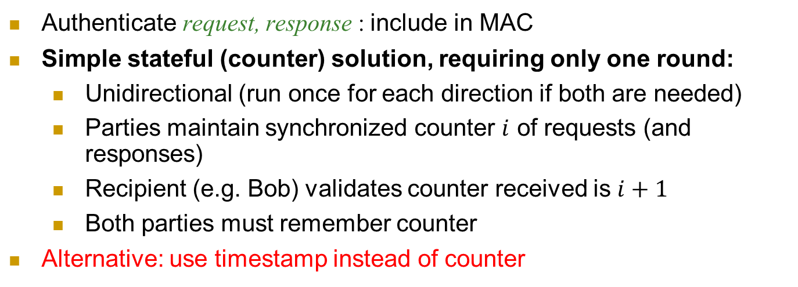

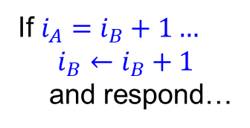


Counter-Based Authenticated Request/Response
Authenticate request, response : include in MAC
Simple stateful (counter) solution, requiring only one round:
Unidirectional (run once for each direction if both are needed)
Parties maintain synchronized counter $i$ of requests (and responses)
Recipient (e.g. Bob) validates counter received is $i+1$
Both parties must remember counter
Alternative: use timestamp instead of counter
Alice
Bob
req, i_{A}, Mac_{k}(1 || A→B || $i_{A}$ || req)
If $i_{A}=i_{B}+1…$
$$i_{B}←i_{B}+1$$
and respond…
If $i_{A}=i_{B}…$
resp, i_{B} , Mac_{k}(2 || A←B || $i_{B}$ ||resp )
Notes:
28
(c) Amir Herzberg, http://AmirHerzberg.com, Bar Ilan University
11/13/11

Slide 29
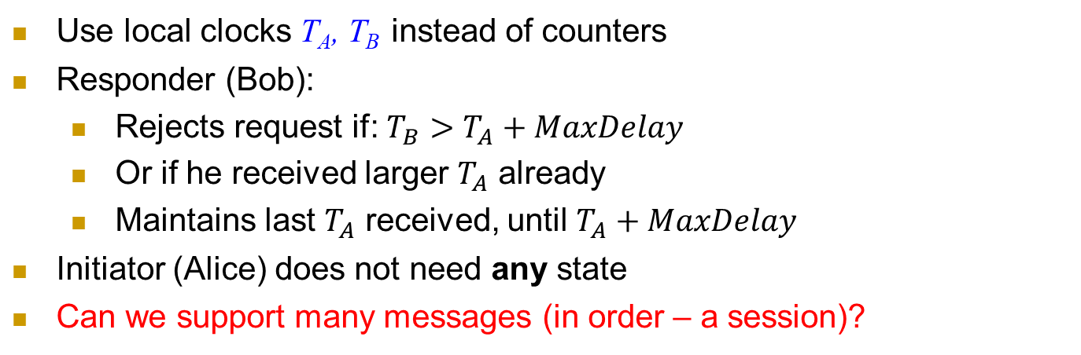
Time-Based Authenticated Request/Response
Use local clocks T_{A}, T_{B} instead of counters
Responder (Bob):
Rejects request if: $T_{B}>T_{A}+MaxDelay$
Or if he received larger $T_{A}$ already
Maintains last $T_{A}$ received, until $T_{A}+MaxDelay$
Initiator (Alice) does not need any state
Can we support many messages (in order – a session)?
Alice
Bob
req, T_{A}, Mac_{k}(1 || A→B || T_{A} || req)
Validate T_{A}
is new
resp , Mac_{k}(2 || A←B ||T_{A} ||resp )
Remember T_{A}
Notes:
29
(c) Amir Herzberg, http://AmirHerzberg.com, Bar Ilan University
11/13/11

Slide 30
2PP: Extensions and Variants
Authenticate session: add sequence numbers
Combine handshake and record protocols
Can we also use the key to protect confidentiality, too? How?
Alice
Bob
A, N_{A}
N_{B}
req1 , Mac_{k}(3 || A→B || N_{A} || N_{B} || req1 )
resp1 , Mac_{k}(4 || A←B ||N_{A} || N_{B} ||resp1 )
req2 , Mac_{k}(5 || A→B || N_{A} || N_{B} || req2 )
resp2 , N_{B} , Mac_{k}(6 || A←B ||N_{A} || N_{B} ||resp2 )
Notes:
30
(c) Amir Herzberg, http://AmirHerzberg.com, Bar Ilan University
11/13/11

Slide 31
2PP: Extensions and Variants
Secure connection: authentication, freshness, secrecy
Independent keys: for encryption k.e, for authentication: k.a
How can we derive them both from a single key k ?
k.e=PRP_{k}(“Encrypt”), k.a=PRP_{k}(“MAC”)
Hmm… same key encrypts all messages, in all sessions ☹
Can we improve security, by changing keys, e.g., btw sessions ?
Alice
Bob
A, N_{A}
N_{B}
E_{k.e}(req) , Mac_{k.a}(3 || A→B || N_{A} || N_{B} || E_{k.e}(req) )
E_{k.e}(resp) , Mac_{k.a}(4 || A←B ||N_{A} || N_{B} || E_{k.e}(resp))
Notes:
31
(c) Amir Herzberg, http://AmirHerzberg.com, Bar Ilan University
11/13/11

Slide 32
Shared-Key Handshake and Record Protocols: Topics
Introduction to (shared key) crypto-protocols
Entity Authentication
Record Authentication (entities+messages)
Key-setup handshakes
GSM handshake case study, and:
Key distribution
Ciphersuite negotiation and downgrade attacks
Improving resiliency to key exposures

Slide 33
2PP: Extensions and Variants
Independent session keys, e.g. k=PRF_{MK}(N_{A},N_{B})
Or, `directly’ for authentication and for encryption: k.e=PRF_{MK}(“Encrypt”, N_{A},N_{B}), k.a=PRF_{MK}(“MAC”, N_{A},N_{B})
Improves security:
Exposure of session key does not expose (long-term) ‘master key’ MK
And does not expose keys of other sessions
Limited amount of ciphertext exposed with each session key k (or k.e)
Better: separate keys from A→B from keys from B→A (why? how?)
Later: reduce risk also from exposure of Master Key MK
Alice
Bob
A, N_{A}
N_{B}
E_{k.e}(req) , Mac_{k.a}(3 || A→B || N_{A} || N_{B} || E_{k.e}(req) )
E_{k.e}(resp) , N_{B} , Mac_{k.a}(4 || A←B ||N_{A} || N_{B} || E_{k.e}(resp))
Notes:
33
(c) Amir Herzberg, http://AmirHerzberg.com, Bar Ilan University
11/13/11

Slide 34
Shared-Key Handshake and Record Protocols: Topics
Introduction to (shared key) crypto-protocols
Record protocols
Handshake protocols: entity authentication
Handshake: extensions
Key-setup handshakes
GSM handshake case study, and:
Key distribution
Ciphersuite negotiation and downgrade attacks
Improving resiliency to key exposures

Slide 35
Key Distribution Center (KDC)
KDC: shares keys with all parties (k_{A}, k_{B}…)
Goal: help parties (A, B) establish k_{AB}
A time-based, stateless KDC variant:
Alice: 2PP with KDC, receive k_{AB} and Bob’s ticket
Ticket: encrypted, authenticated k_{AB}
Use time to ensure freshness and limit usage
Client (Alice)
KDC
Server (Bob)
2PP (Alice to KDC): k_{AB} , Ticket
Ticket + 2PP (Alice to Bob): use k_{AB} as shared key
Notes:
KDC = TGS (Ticket Granting Server) [Kerberos]

Slide 36
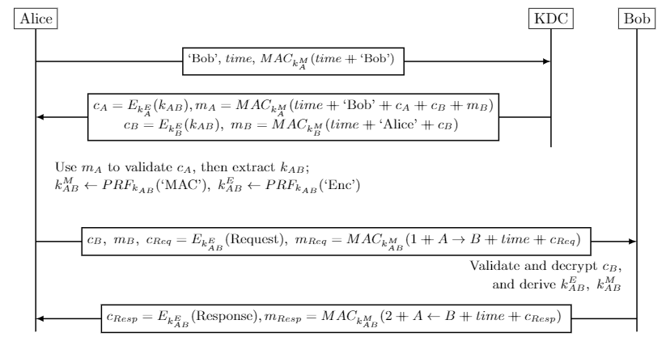
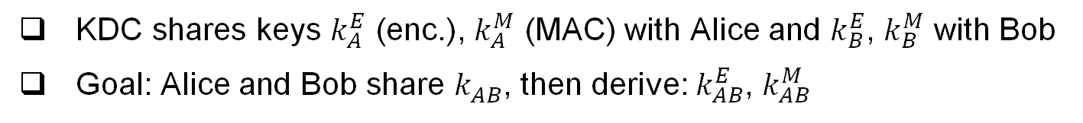
KDC Protocol
KDC shares keys $k_{A}^{E}$ (enc.), $k_{A}^{M}$ (MAC) with Alice and $k_{B}^{E}$, $k_{B}^{M}$ with Bob
Goal: Alice and Bob share $k_{AB}^{}$, then derive: $k_{AB}^{E}$, $k_{AB}^{M}$

Slide 37
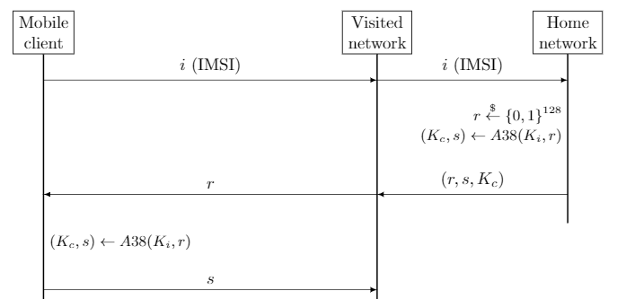
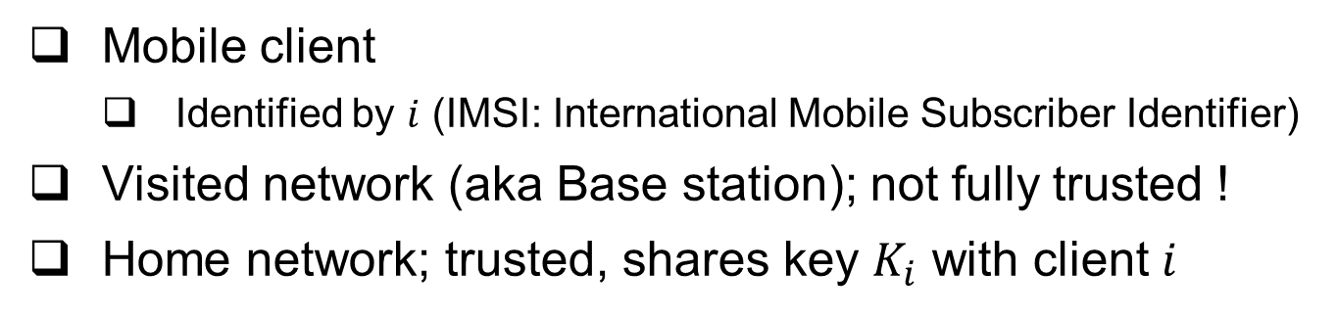
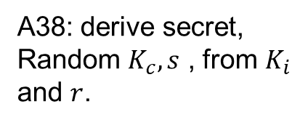
The GSM Handshake Protocol
Mobile client
Identified by $i$ (IMSI: International Mobile Subscriber Identifier)
Visited network (aka Base station); not fully trusted !
Home network; trusted, shares key $K_{i}$ with client $i$
A38: derive secret,
Random $K_{c}, s$ , from $K_{i}$ and $r$.
GSM spec: OWF
But really should be…
a PRF !

Slide 38
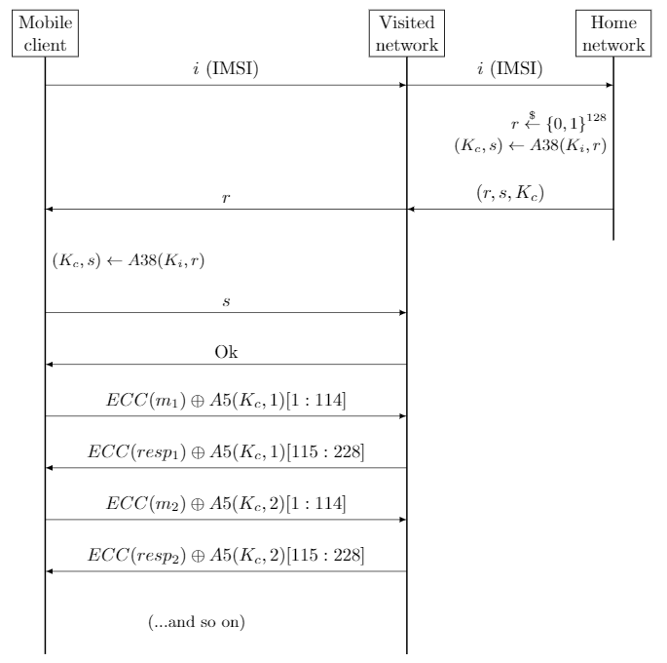
A5: provide ‘pad’ for encryption
Several variants: A5/1 - `regular’
A5/2 - `waak’
A5/3 – more secure
Really should be…
a PRF !

Slide 39
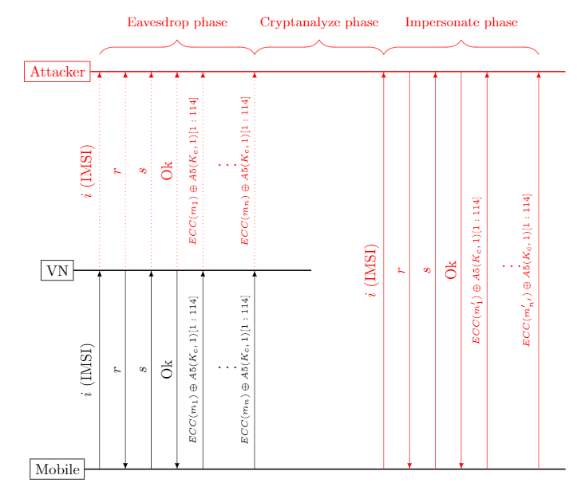
Visited-net Impersonation Attack
Note: does NOT
Impersonate mobile, only
Visited network.
And requires key…

Slide 40
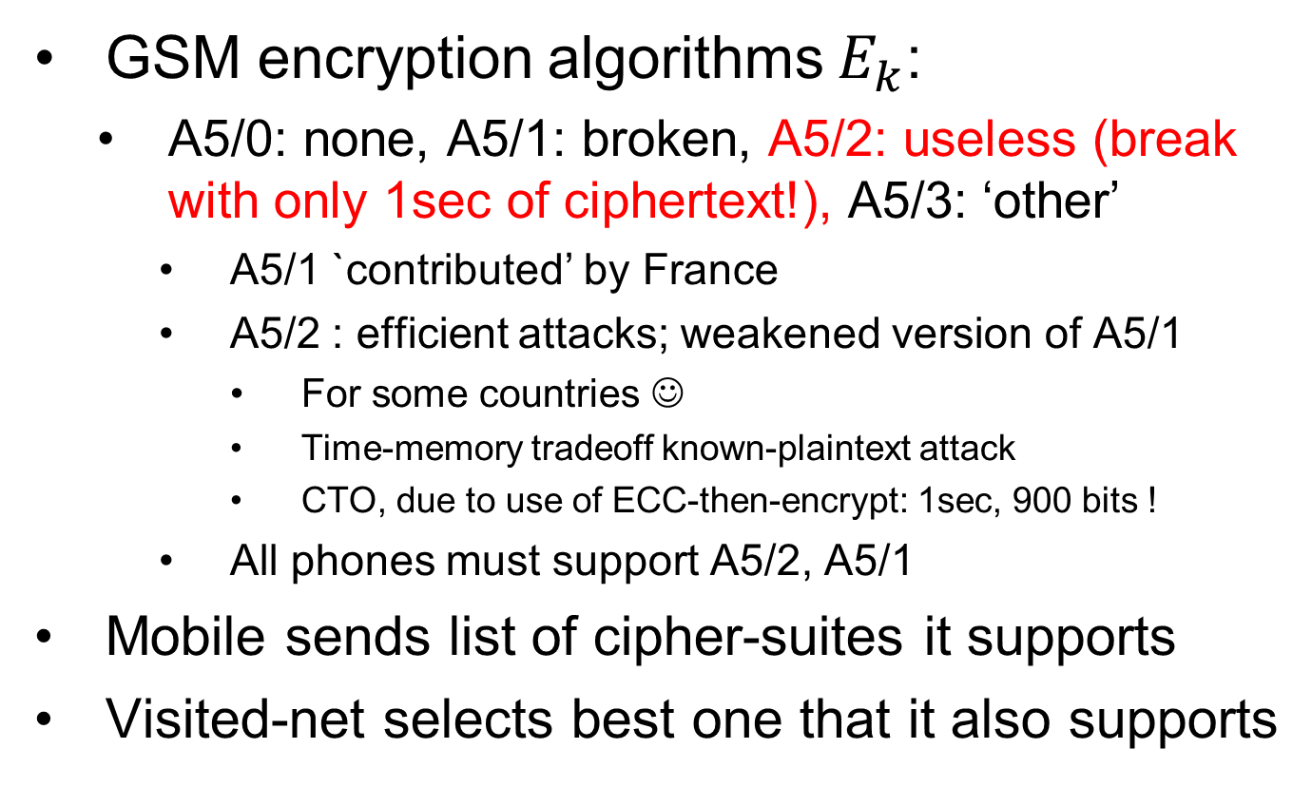
GSM: Cipher Suites
GSM encryption algorithms $E_{k}$:
A5/0: none, A5/1: broken, A5/2: useless (break with only 1sec of ciphertext!), A5/3: ‘other’
A5/1 `contributed’ by France
A5/2 : efficient attacks; weakened version of A5/1
For some countries ☺
Time-memory tradeoff known-plaintext attack
CTO, due to use of ECC-then-encrypt: 1sec, 900 bits !
All phones must support A5/2, A5/1
Mobile sends list of cipher-suites it supports
Visited-net selects best one that it also supports

Slide 41
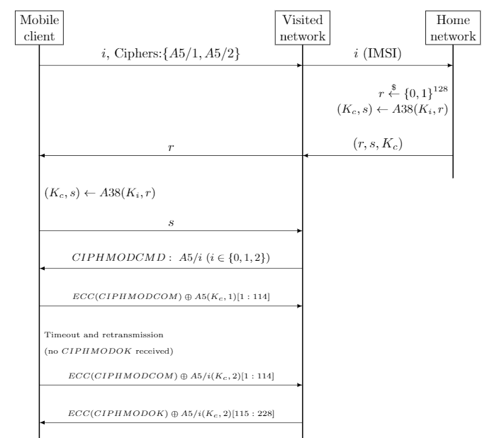
GSM
Handshake,
With
Cipher-negotiation.

Slide 42
Cipher mode messages, negotiation
Mobile sends list of supported ciphers
VN sends choice in: CIPHMODCMD
Cipher Mode Command
Mobile confirms by sending encrypted: CIPHMODCOM: cipher mode complete
If not received (in few msecs), VN disconnects
VN Acks: CIPHMODOK: cipher mode Ok
If not received, mobile resends CIPHMODCOM

Slide 43
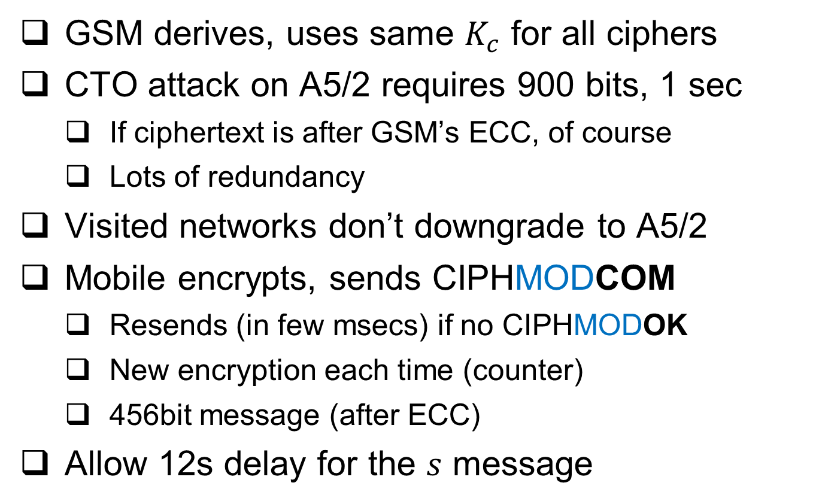
GSM ciphersuite facts: for fun and profit
GSM derives, uses same $K_{c}$ for all ciphers
CTO attack on A5/2 requires 900 bits, 1 sec
If ciphertext is after GSM’s ECC, of course
Lots of redundancy
Visited networks don’t downgrade to A5/2
Mobile encrypts, sends CIPHMODCOM
Resends (in few msecs) if no CIPHMODOK
New encryption each time (counter)
456bit message (after ECC)
Allow 12s delay for the $s$ message

Slide 44

GSM: Simplified* Downgrade Attack
Efficient attack known only for A5/2; Client, Visited-net normally prefers A5/3 or A5/1, which are harder to break. Attack forces use of A5/2 !!
Client
MitM
Visited network
IMSI, Ciphers {A5/1, A5/2}
IMSI, Ciphers {A5/2}
r
r
s
Start, CipherSuite (A5/2)
$m⨁E_{k}^{A5/2}(1$)
* Standard says Visited-nets should not agree to use A5/2, since all clients support A5/1 ➔ this attack fails for conforming VNs

Slide 45
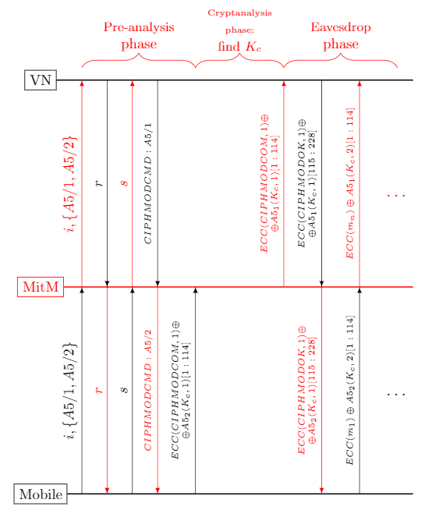
2nd Simplified downgrade attack
Fail in practice, since:
1. VN would time-out since CIPHMODCOM
Is not received in few milliseconds
2. And CIPHMODCOM
is only 456 bits
Attack needs 900!

Slide 46


GSM: ‘Real’ Downgrade Attack
Works even if VN insists to use A5/1; attacker tricks client to use A5/2. That suffices, since GSM uses same key for all cryptosystems!
Client
MitM
Visited-Net (VN)
IMSI, Ciphers {A5/1, A5/2}
IMSI, Ciphers {A5/1, A5/2}
r
r
s
Start, CipherSuite (A5/2)
$m⨁E_{k}^{A5/2}(1$)
Max1 ~ 10sec
Cryptanalyze, find k (<1sec)
s
Start, CipherSuite (A5/1)
$m⨁E_{k}^{A5/1}(1$)
Max2 << 1sec

Slide 47
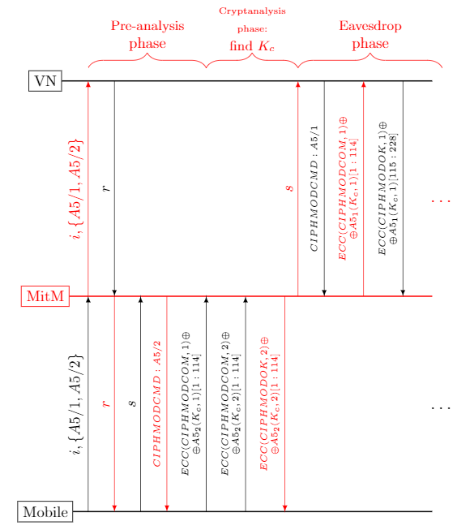

Slide 48
Shared-Key Handshake and Record Protocols: Topics
Introduction to (shared key) crypto-protocols
Record protocols
Handshake protocols: entity authentication
Handshake: extensions
Key-setup handshakes
GSM handshake case study, and:
Key distribution
Ciphersuite negotiation and downgrade attacks
Improving resiliency to key exposures

Slide 49
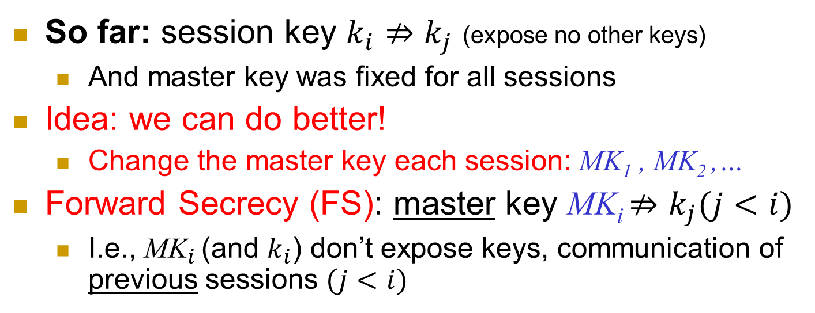



Improve resiliency to key exposures
So far: session key $k_{i}⇏k_{j}$ (expose no other keys)
And master key was fixed for all sessions
Idea: we can do better!
Change the master key each session: MK₁ , MK₂ ,…
Forward Secrecy (FS): master key MK_{i} $⇏k_{j}(j<i)$
I.e., ${\text{MK}}_{i}$ (and $k_{i}$) don’t expose keys, communication of previous sessions $(j<i)$
Secure MK₁
Keys Exposed
MK₂
Stays insecure
MK₃
$$k_{1}={PRF}_{{MK}_{1}}(N_{A}(1)||N_{B}(1))$$
$$k_{2}={PRF}_{{MK}_{2}}(N_{A}(2)||N_{B}(2))$$
$$k_{3}=…$$
Notes:
49
(c) Amir Herzberg, http://AmirHerzberg.com, Bar Ilan University
11/13/11
`Perfect’ is not really the right term… but that’s the commonly used term.

Slide 50

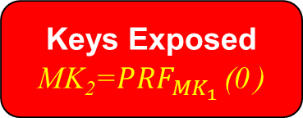
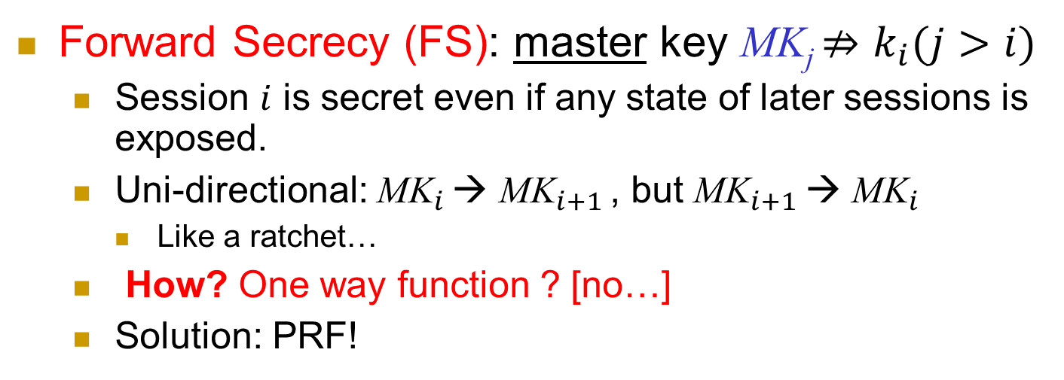

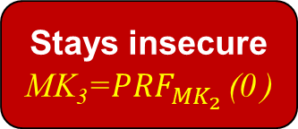
Improve resiliency to key exposures
Forward Secrecy (FS): master key MK_{j} $⇏k_{i}(j>i)$
Session $i$ is secret even if any state of later sessions is exposed.
Uni-directional: ${\text{MK}}_{i}$ → ${\text{MK}}_{i+1}$ , but ${\text{MK}}_{i+1}$ → ${\text{MK}}_{i}$
Like a ratchet…
How? One way function ? [no…]
Solution: PRF!
MK_{i}=${PRF}_{{MK}_{i−1}}$ (0 )
Secure MK₁
Keys Exposed
MK₂=${PRF}_{{MK}_{1}}$ (0 )
Stays insecure
MK₃=${PRF}_{{MK}_{2}}$ (0 )
$$k_{1}={PRF}_{{MK}_{1}}(N_{A}(1)||N_{B}(1))$$
$$k_{2}={PRF}_{{MK}_{2}}(N_{A}(2)||N_{B}(2))$$
$$k_{3}=…$$
Notes:
50
(c) Amir Herzberg, http://AmirHerzberg.com, Bar Ilan University
11/13/11
`Perfect’ is not really the right term… but that’s the commonly used term.

Slide 51
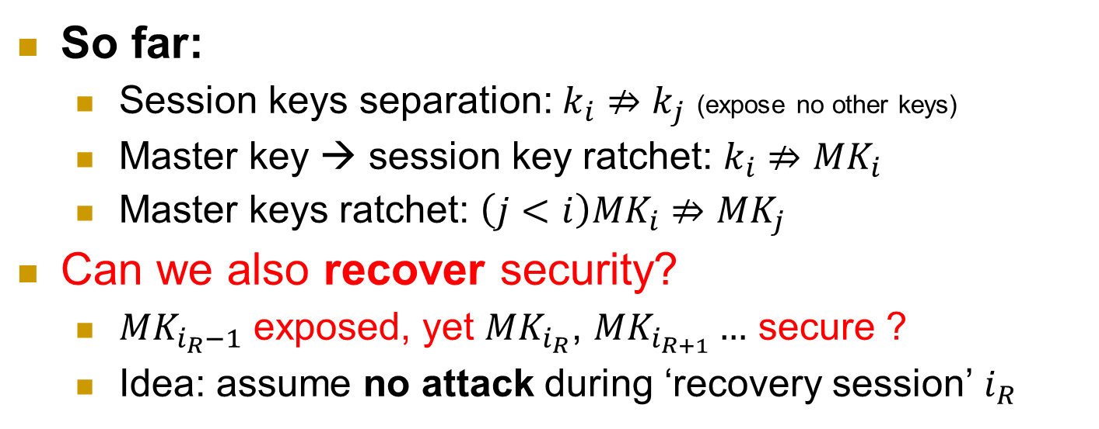


Improve resiliency to key exposures
So far:
Session keys separation: $k_{i}⇏k_{j}$ (expose no other keys)
Master key → session key ratchet: $k_{i}⇏{MK}_{i}$
Master keys ratchet: ${\left(j<i\right)MK}_{i}⇏{MK}_{j}$
Can we also recover security?
${MK}_{i_{R}−1}$ exposed, yet ${MK}_{i_{R}}$, ${MK}_{i_{R+1}}…$ secure ?
Idea: assume no attack during ‘recovery session’ $i_{R}$
Keys Exposed
MK₁
No attack: recover !
MK₂
Stays secure
MK₃
$$k_{1}={PRF}_{{MK}_{1}}(N_{A}||N_{B})$$
$$k_{2}={PRF}_{{MK}_{2}}(N_{A}||N_{B})$$
$$k_{3}=…$$
Notes:
51
(c) Amir Herzberg, http://AmirHerzberg.com, Bar Ilan University
11/13/11
`Perfect’ is not really the right term… but that’s the commonly used term.

Slide 52

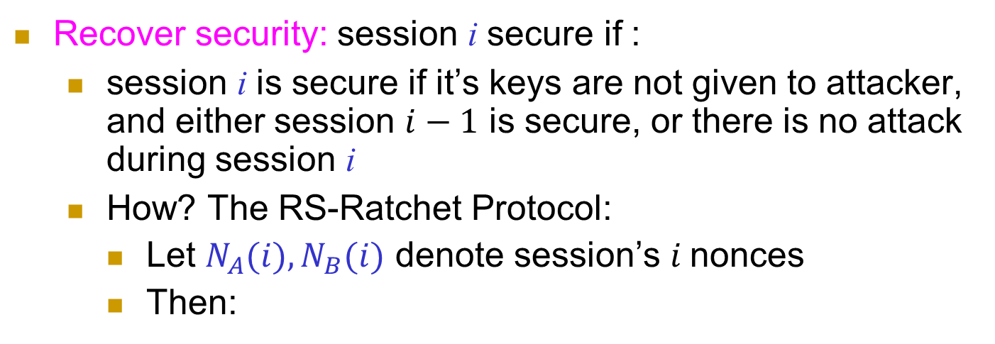
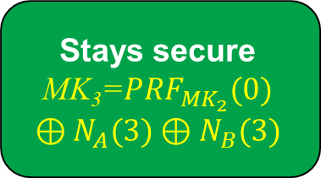
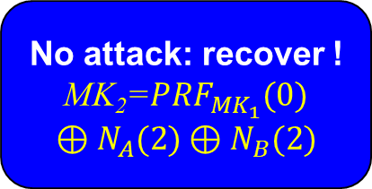



Recover Security (RS)
Recover security: session i secure if :
session i is secure if it’s keys are not given to attacker, and either session $i−1$ is secure, or there is no attack during session i
How? The RS-Ratchet Protocol:
Let $N_{A}(i), N_{B}(i)$ denote session’s $i$nonces
Then:
$$\text{MK}\text{i}={PRF}_{{MK}_{i−1}}(0)⊕N_{A}(i)⊕N_{B}(i)$$
Keys Exposed
MK₁
No attack: recover !
MK₂=${PRF}_{{MK}_{1}}(0)⊕N_{A}(2)⊕N_{B}(2)$
Stays secure
MK₃=${PRF}_{{MK}_{2}}(0)$ $$⊕N_{A}(3)⊕N_{B}(3)$$
$$k_{1}={PRF}_{{MK}_{1}}(N_{A}(1)||N_{B}(1))$$
$$k_{2}={PRF}_{{MK}_{2}}(N_{A}(2)||N_{B}(2))$$
$$k_{3}=…$$
Notes:
52
(c) Amir Herzberg, http://AmirHerzberg.com, Bar Ilan University
11/13/11
`Perfect’ is not really the right term… but that’s the commonly used term.

Slide 53
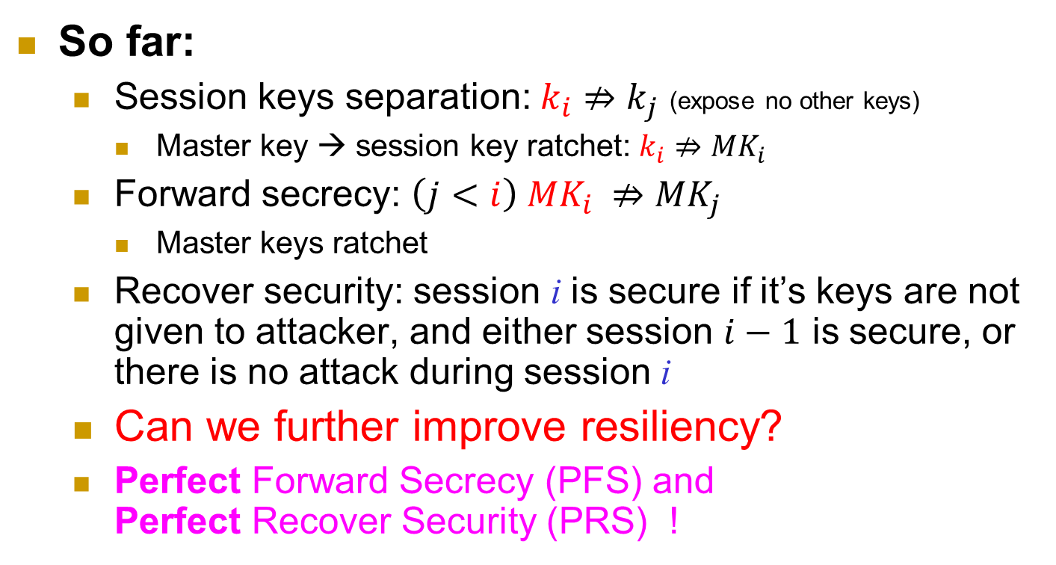
Improve resiliency to key exposures
So far:
Session keys separation: $k_{i}⇏k_{j}$ (expose no other keys)
Master key → session key ratchet: $k_{i}⇏{MK}_{i}$
Forward secrecy: ${\left(j<i\right) MK}_{i} ⇏{MK}_{j}$
Master keys ratchet
Recover security: session i is secure if it’s keys are not given to attacker, and either session $i−1$ is secure, or there is no attack during session i
Can we further improve resiliency?
Perfect Forward Secrecy (PFS) and Perfect Recover Security (PRS) !
Notes:
53
(c) Amir Herzberg, http://AmirHerzberg.com, Bar Ilan University
11/13/11
`Perfect’ is not really the right term… but that’s the commonly used term.

Slide 54
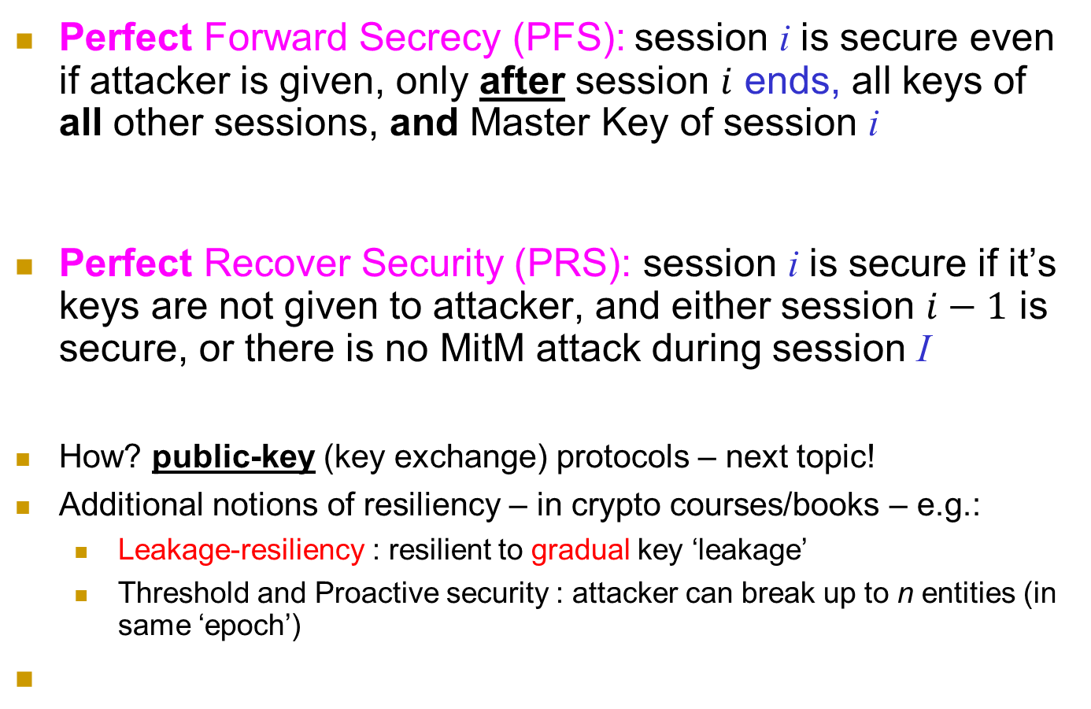
Perfect Forward, Recover Secrecy
Perfect Forward Secrecy (PFS): session i is secure even if attacker is given, only after session $i$ ends, all keys of all other sessions, and Master Key of session i
Perfect Recover Security (PRS): session i is secure if it’s keys are not given to attacker, and either session $i−1$ is secure, or there is no MitM attack during session I
How? public-key (key exchange) protocols – next topic!
Additional notions of resiliency – in crypto courses/books – e.g.:
Leakage-resiliency : resilient to gradual key ‘leakage’
Threshold and Proactive security : attacker can break up to n entities (in same ‘epoch’)
Notes:
54
(c) Amir Herzberg, http://AmirHerzberg.com, Bar Ilan University
11/13/11
`Perfect’ is not really the right term… but that’s the commonly used term.

Slide 55
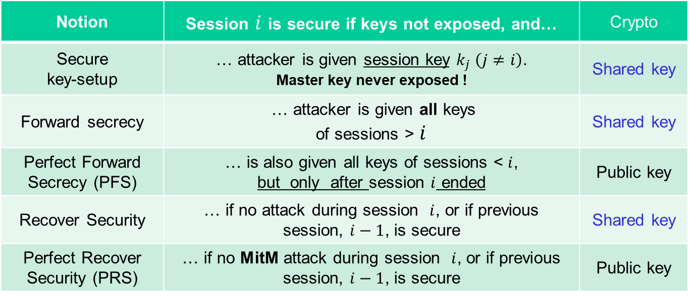
Resiliency Notions: Shared + Public Key
Notion | Session $i$ is secure if keys not exposed, and… | Crypto
Secure key-setup | … attacker is given session key $k_{j} \left(j≠i\right)$. Master key never exposed ! | Shared key
Forward secrecy | … attacker is given all keys of sessions > $i$ | Shared key
Perfect Forward Secrecy (PFS) | … is also given all keys of sessions < $i$, but only after session $i$ ended | Public key
Recover Security | … if no attack during session $i$, or if previous session, $i−1$, is secure | Shared key
Perfect Recover Security (PRS) | … if no MitM attack during session $i$, or if previous session, $i−1$, is secure | Public key
Secure key setup
FS
PFS
RS
PRS
Notes:
55
(c) Amir Herzberg, http://AmirHerzberg.com, Bar Ilan University
11/13/11
`Perfect’ is not really the right term… but that’s the commonly used term.

Slide 56
Conclusion
Secure handshake protocols seem easy…
But are easy to get wrong!
Many vulnerable proposed, deployed systems
Precise definitions and proofs are not so simple
Also: many variants
Advanced features require public key crypto
Next: public key cryptology
Key Exchange
Encryption
Signatures
Notes:
56
(c) Amir Herzberg, http://AmirHerzberg.com, Bar Ilan University
11/13/11

